Slide 1
Term Project
Group 7
Lily Ren | Suzana Trac | Owen Zhao | Haoran Liang

Slide 2
Table of Contents
1) Project Understanding
4) Assignment A Approach
7) Assignment B Approach
2) Assignment A Background
5) Assignment A Results
8) Assignment B Results
3) Assignment A - What We Know
6) Assignment B Background

Slide 3

Project Understanding
Resource-Constrained Multi-Project Scheduling Problem (RCMPSP).
As many companies carry out a portfolio of projects in simultaneous, subject to precedence and resource constraints, RCMPSP has numerous published academic studies and a well-established system of nomenclatures, heuristic methodologies, databases, solution procedures, and models [1].
Notes:
With the information provided, Group 7 understands that we require a solution to a Resource-Constrained Multi-Project Scheduling Problem, in which a portfolio of projects is scheduled, and project implementation requires sharing organization resources amongst the multiple projects. In Assignment A, projects are provided different priorities and in Assignment B, the objective is to minimize delay costs. Constraints and prescribed timelines limit the projects that can occur within specific time periods and management methods are required to allocate resources and schedule projects within a portfolio.
The approach to solve the project will involve assuming each project within the portfolio as an activity within a mega-project. This is a method that is widely referenced in literature. A significant amount f research has also been completed in RCMPSP because the problem is applicable and relevant in the construction industry.

Slide 4
Assignment A

Slide 5

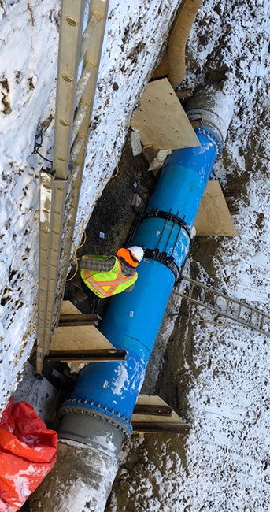
Assignment A Background
Scheduling of projects in a municipal drainage and water infrastructure portfolio. Projects have 3 categories:
01 | Client-demanded projects
02 | Prioritized projects
03 | Emergency projects
Notes:
Assignment A involves a portfolio of municipal drainage and water infrastructure initiatives that the problem asks us to schedule. These projects are separated into 3 categories:
Client-demanded projects involve infrastructure installation or repairs, prioritized projects that are assigned a priority related to the risk to normal operations, and emergency projects that need immediate response to mitigate significant client impacts.

Slide 6
What We Know - Assignment Parameters
Priority Index PI_{j}
Date Ready = Early Start (ES)
Deadline = Late Finish (LF)
Standard Calendar and Hours
What we can infer:
LF - ES - Duration = Slack
No Relationships Between Projects
8 Crews Available
The Priority Index has been calculated using EPCOR’s proprietary software and has been provided in the assignment.
No Priority Rule Heuristics are needed to determine project priorities.
A standard 5 days per week, 8 hours per day calendar is followed with the exception of October 9 being a statutory holiday.
In total, the planning horizon of three weeks starts on October 2 and ends on October 23.
The Site Ready date establishes the Early Start while the deadline establishes the Late Finish.
Relationships
Crew
Priority
Dates Provided
Calendar
Projects are independent of one another with no dependency or precedence relationship
We are exploring a static RCMPSP where there are no precedence relationships between the projects. The portfolio can be treated as one mega-project and each of the projects are treated as non-precedence activity.
Each crew can perform at most one project at a time.
Projects cannot be split between crews.
Each crew is ready at the respective worksite at the beginning of each work day, travel time does not need to be accounted for.

Slide 7
What We Know - Resource Capacity
Three Week Planning Window - Oct 23
Deadline On and Before Oct 23
118
150
<
Days of Resource Capacity at 8 Crews
Days of Project Work
Browning & Yassine (2010):
At any time, if a set of non-precedence constrained projects where ΣR_{k} < Σd,
then some projects will be delayed
Four Week Planning Window - Oct 28
All Projects - Deadline On and Before Oct 28
150
191
<
Days of Resource Capacity at 8 Crews
Days of Project Work
* R_{k} - Resource Capacity; d - Duration
Notes:
Based on Browning & Yassine, projects are delayed when the resource capacity is less than the duration required to complete all desired projects. Question 1 of Assignment A has a resource capacity of 118 days based on the 8 available crews over the 3 week planning window. 149 days of work is required to complete applicable projects by October 23. For question 2, a resource capacity of 158 days is available for a 4 week planning window, compared to 191 days of work that is required to complete all projects by October 28. So the conclusion is that for both Questions 1 and 2, there will be projects that are delayed.

Slide 8
Assignment A Approach
Overall Assignment A goals are:
Optimally allocate constrained resources to maximize higher priority project completion within 3 week period (Question 1)
Update baseline schedule to minimize schedule adjustment to address the emergency project (Question 3)
1
3
2
Optimally allocate constrained resources to unplanned projects in Question 1 to reduce overall portfolio duration (Question 2)

Slide 9
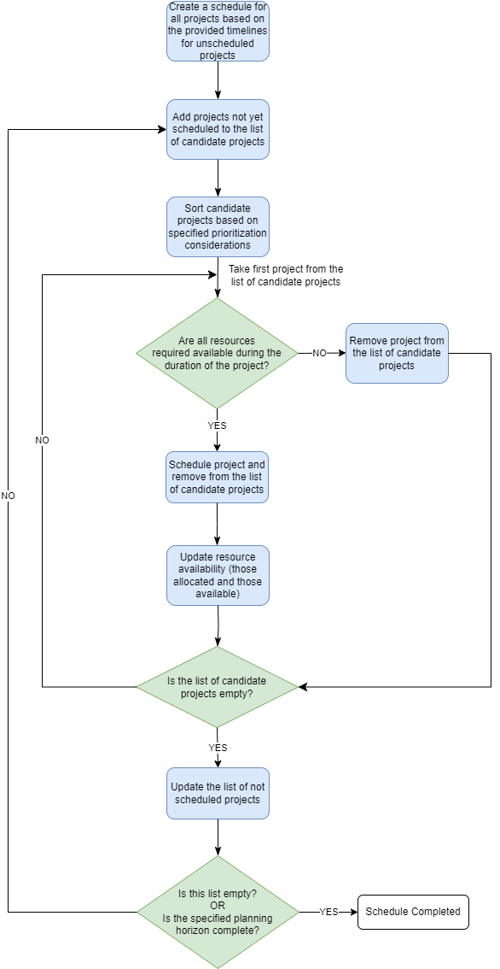


Assignment A Approach
Parameters for consideration
Sort By Assigned Project Priority Index
LF - ES - Duration = Slack
Slack / Max Slack = Slack Index
Sort By Minimum Slack Index
Consider Earliest Deadline
Consider Early Start
01
02
01
02
03
04

Slide 10
Manual Solution VS Microsoft Project
Q1. First isolate projects with deadline on and before October 23, sort by priority, slack index, deadline, and site ready date considerations. Manually assign crew following the list of considerations above, prioritizing high priority projects.
Q2. Manually fit the rest of the projects with priority, slack index, deadline, and site ready date considerations. Minimize the number of delayed projects wherever possible.
Q3. Manually insert emergency project on October 10 and bump low priority project.
Q1 & Q2. Assign 1 crew with 800% capacity over the planning horizon with the exception of 600% capacity on October 23.
Use Leveling Order “Priority, Standard”, which uses the priority field first (weighted 900, 800…) and then examines predecessor dependencies, slack, dates, and constraints
Q3. Include “Emergency Project” with a start no earlier than “October 10” and level 1000 priority prior to resource levelling

Slide 11
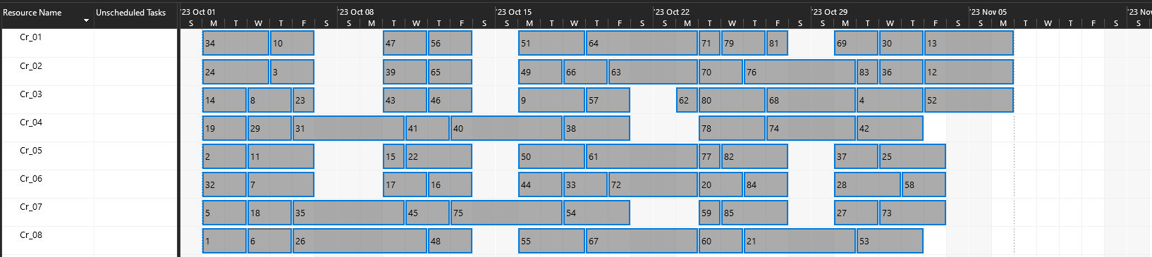
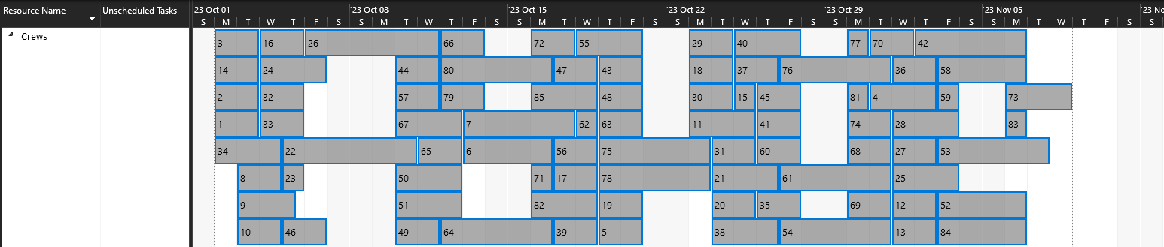
Manual
A.1 & A.2
Microsoft Project

Slide 12
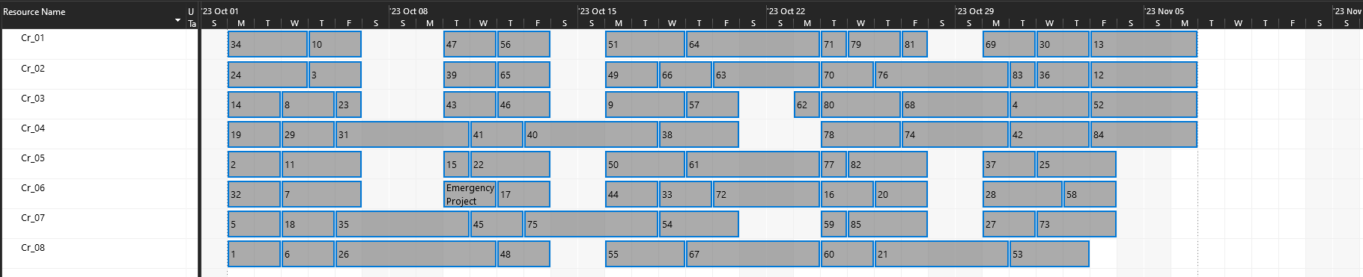
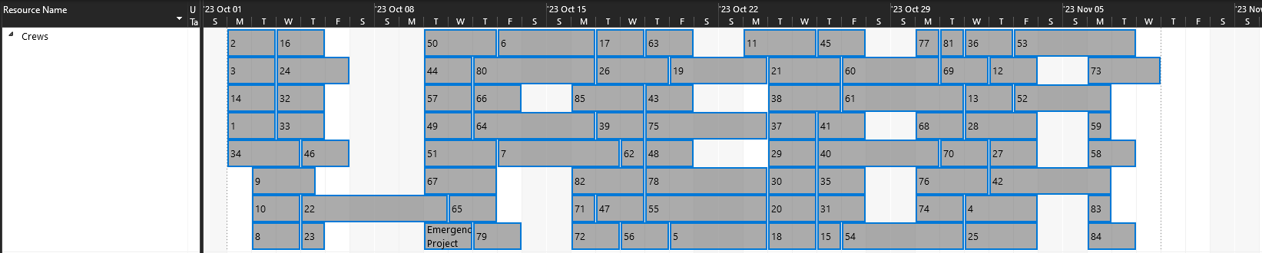
Manual
A.3
Microsoft Project

Slide 13
Manual Solution VS Microsoft Project
Q1. 50 projects were scheduled to October 23
Pij = 1 (17 projects)
Pij = 2 (21 projects)
Pij = 3 (12 projects)
Q2. 85 projects were scheduled to November 6
62 projects are scheduled on time
23 projects are delayed
Q3. An “emergency” project is added to the list of projects and manually scheduled on October 10, replacing/bumping the projects that follow
61 projects are scheduled on time
1 emergency project is scheduled on time
24 projects are now delayed
Q1 & Q2. 85 projects were scheduled to November 8
44 projects are scheduled on time
41 projects are delayed
Q3. An “emergency project” is added to the list of projects for resource levelling
43 projects are schedule on time
1 emergency project is scheduled on time
42 projects are now delayed

Slide 14
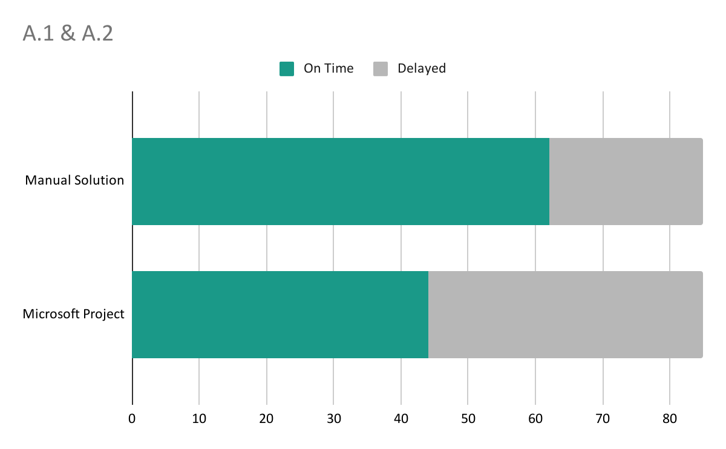

Results Comparison

Slide 15
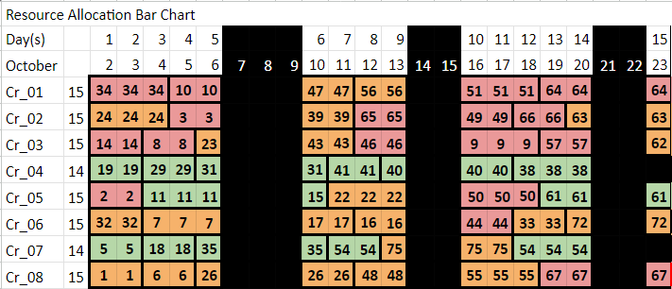
Assignment A.1

Slide 16
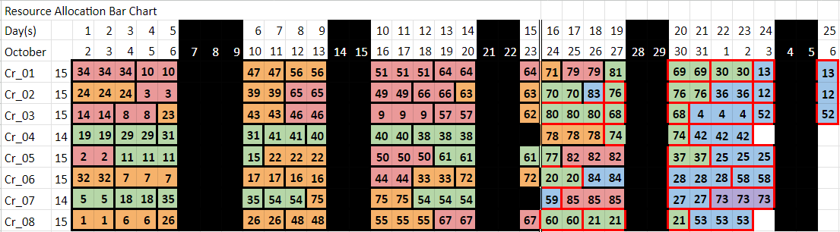
Assignment A.2

Slide 17
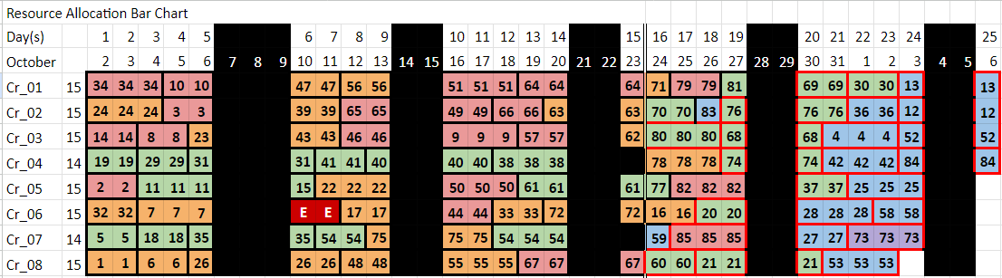
Assignment A.3

Slide 18
Assignment B

Slide 19
Assignment B Background
Strategize to execute twenty projects over three weeks using three crews, all under a fixed contract price. Our primary objective is to minimize penalties and liquidated damages and maximizing profitability
01 | Finish the projects required by clients
02 | Reduce the delay penalty and liquidated damage
03 | Maximizing profitability

Slide 20
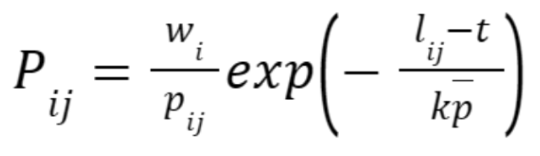
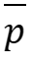
Assignment B Approach
Original Priority Index [1]:
w_{i} | the penalty costs incurred for each time unit of delay
 | the average duration of all projects, and pij is the certain project duration
l_{ij} | the latest starting date for a project before delay costs are incurred
k | an empirically determined planning parameter（ k=12)
t | the date currently being scheduled
[1]S. R. Lawrence and T. E. Morton, “Resource-constrained multi-project scheduling with tardy costs: Comparing myopic, bottleneck, and resource pricing heuristics,” Eur J Oper Res, vol. 64, no. 2, pp. 168–187, Jan. 1993, doi: 10.1016/0377-2217(93)90175-M.
Notes:
。

Slide 21
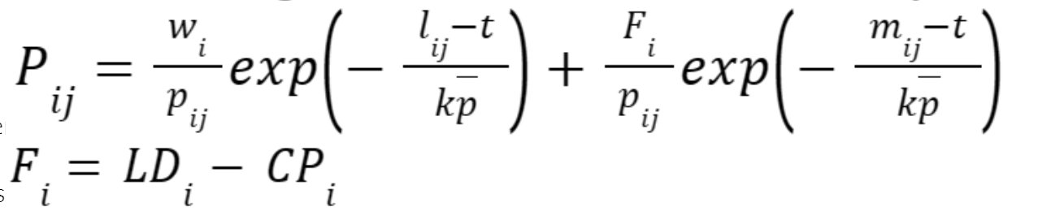
Assignment B Approach
Modified Priority Index :
F_{i} | the difference between liquidated damage LD_{i} and contract price CP_{i}
m_{ij} | the latest starting date for a project before liquidated damage is incurred
w_{i} | the penalty costs incurred for each time unit of delay
 | the average duration of all projects, and pij is the project duration
l_{ij} | the latest starting date for a project before delay costs are incurred
k | an empirically determined planning parameter（ k=12)
t | the date currently being scheduled

Slide 22
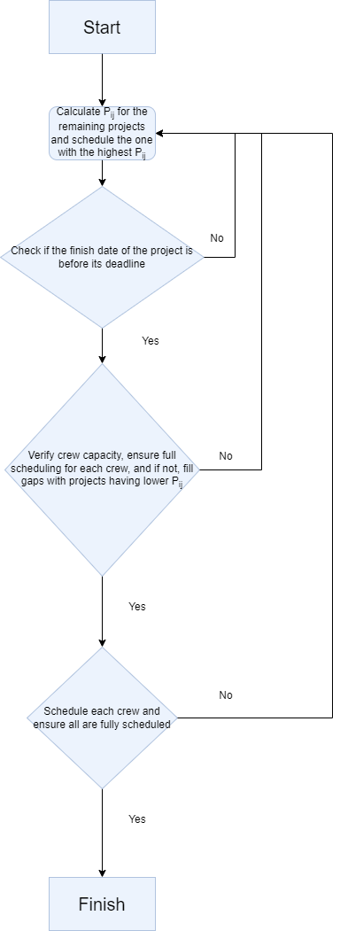
Assignment B
Approach
Proposed Methodology

Slide 23

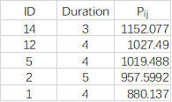
Maximize crew utilization
Remaining projects for crew #3

Slide 24
Maximize crew utilization
Remaining projects for crew #3

Slide 25
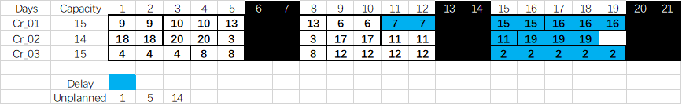
Assignment B Result
The results of scheduling:
Maximize crew utility;
Delayed projects are concentrated in the later stages；
Considering delayed costs and liquidated damages, one could still obtain $148,450 of $205,000 (total contract price).

Slide 26
Thank you.

Slide 27
Assignment A Approach
Question 3 Assumptions
Complete rescheduling to be done per the same methodology per Questions 1 and 2
Projects finished by October 10 are omitted from the original network
Projects started by October 10 but are not yet completed have the projected remainder of project duration as planned duration
Projects in progress can be delayed with no additional time required for start-up and remobilization for completion at a later time
Emergency project is assigned the highest priority and can occur concurrently with other projects

Slide 28
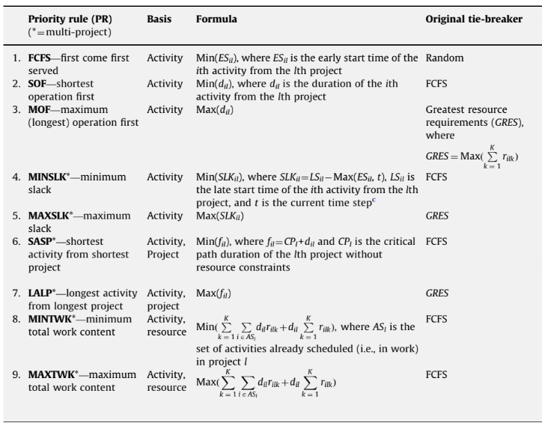
RCMPSP Methodologies
Assignment A
Priority Rule (PR) Heuristics
Advantages: Fast implementation speed and simplicity in algorithmic computation
Notes: Literature is inconclusive about which PR provides the best performance
MINSLK typically performs well
Notes:
Typically priority rules (PR) heuristics are used to determine scheduling priorities for RCMPSPs. PR heuristics are used because they’re relatively simple and fast to implement. Using minimum slack to prioritize projects has been found to work well though literature has remained inconclusive about which PR performs the best.

Slide 29

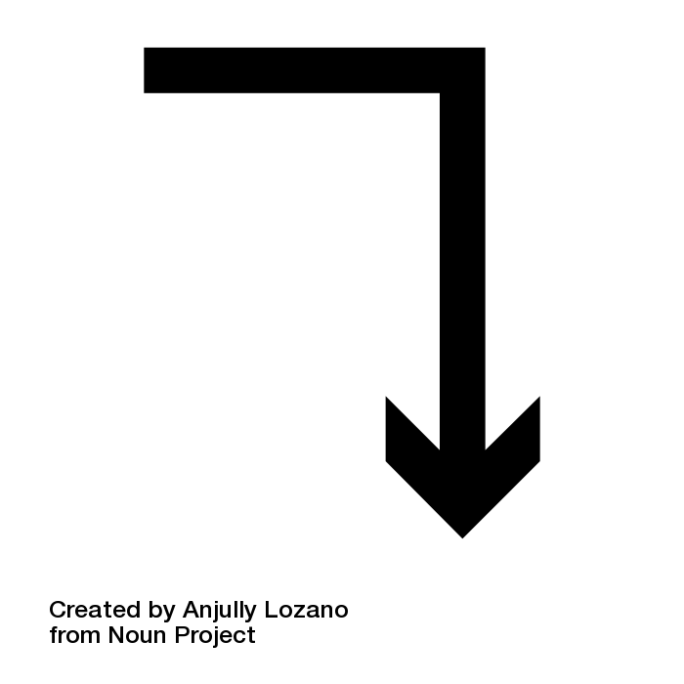
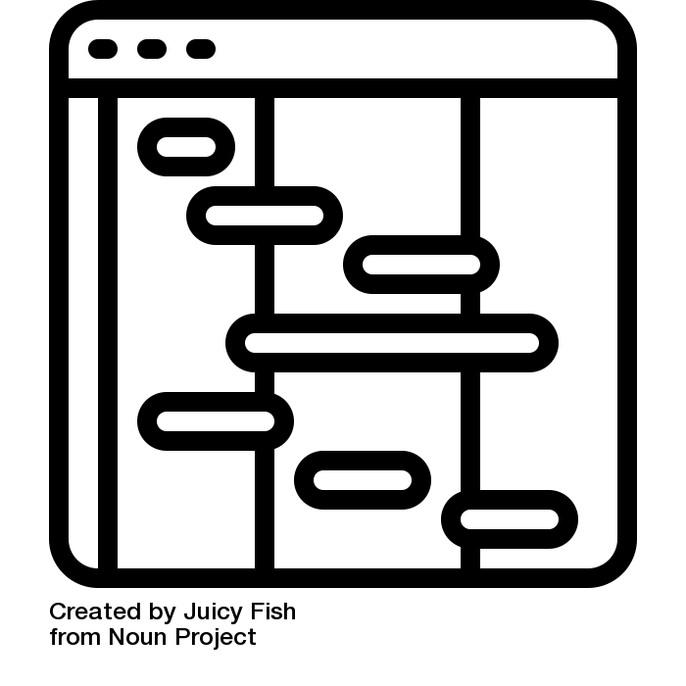
Reactive Project Scheduling Methodology
Assignment A
Complete rescheduling method
Advantages: Excels in makespan performance compared to other methods
Notes: Lack of studies on reactive project scheduling with new project arrival, majority of literature reviewed applied compete rescheduling
Notes:
Reactive project scheduling involves modifying the baseline schedule when unanticipated disturbance events occur. There isn’t much research available on reactive multi-scheduling problems, but methods for reactive scheduling includes complete rescheduling, where a schedule is completely regenerated when disruptions occur. This method is helpful in that it provides better makespan performance and is generally used in most of the literature reviewed.

Slide 30

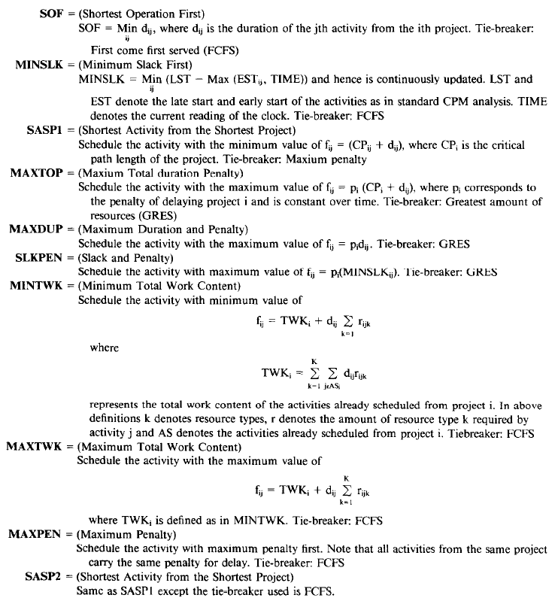
RCMPSP Methodologies
Assignment B
Priority rule (PR) Heuristics
Notes: Literature indicated MAXPEN produced minimum delay penalties
Notes:
PR heuristics were also used in papers looking to minimize delay costs, where using maximum delay penalty to define priorities resulted in the least delay penalties compared to other PRs.

